Slide 1
•
COURSE POSITION 2 OF 14
Practical Command-Line Mechanics
Working with the Linux Shell
Command interpretation, syntax and quoting, documentation discovery, standard streams, pipelines, and safe process management.
2–3 Hours Duration
Interactive GNU Bash
Workspace: ~/lesson2-lab

Slide 2
Foundation & Guardrails
Learning Objectives & Lab Safety
~/lesson2-lab
Predictable Mental Model
Bounded Practice Area
Deliberate Verification
Understand how Bash parses whitespace, expansions, and options before execution.
Confine exercises strictly to . Zero administrative required.
Verify targets before running , , , , or .
>
>>
sudo
rm
source
kill

Slide 3
Interface Paradigms
GUI vs. CLI: Two Means to the Same End
Command-Line Interface
Graphical User Interface
Typed text commands interpreted by an interactive shell program.
Direct manipulation via pointer, menus, icons, and windows.
Best Context: Image editing, desktop multitasking, settings discovery.
Best Context: Remote administration, repetitive tasks, scripting pipelines.
Common Desktops: GNOME (Ubuntu), KDE Plasma, Xfce, LXQt.
Core Strengths: High speed, tiny memory footprint, exact repeatability.
Key Trade-off: Easy discovery, but difficult to script or automate.
Underlying Reality: Both interfaces call the exact same OS kernel services.

Slide 4
System Architecture
What is a Shell?
THE COMMAND INTERPRETER
1. User Inputs Keystrokes
Typed characters pass through the terminal window directly to Bash.
Mediator Between User and OS
The shell is a user-space program that reads commands, interprets syntax, performs expansions, and launches applications.
2. Shell Parses and Expands
Splits words, resolves variables (), aliases, and paths.
$HOME
A terminal emulator (e.g., GNOME Terminal) only handles window display and keystrokes; the shell (GNU Bash) interprets the words.
3. Kernel Dispatches Execution
Kernel spawns process, assigns PID, and connects standard I/O streams.

Slide 5
Execution Model
Shell Builtins vs. External Commands
INTERNAL EXECUTION
EXTERNAL PROGRAMS
Shell Builtins
Executable Binaries
Commands executed directly inside the shell process to inspect or change its own internal state.
Standalone executable files stored on the filesystem (typically found in directories listed in ).
$PATH
cd, alias, export, unset, source, exit
ls, cat, sort, uniq, wc, sleep, nano
Why built-in? Running as a separate child program would change only the child's directory, leaving the parent shell unchanged.
Child Process: The shell forks and executes the binary as a distinct child process with its own PID.
cd

Slide 6
Self-Sufficiency
Finding Help: man, info, and --help
man
info
--help
apropos / whatis
Manual Pages
GNU Info
Quick Help Flag
Keyword Search
Complete reference documentation. Divided into sections (1 = User commands, 5 = File formats).
Hyperlinked menu system providing deep, structured details for GNU Coreutils.
Built-in summary of synopsis and options printed directly to the terminal stdout.
Search manual page descriptions when you do not know the exact command name.
info coreutils
printf --help
apropos directory
man 5 passwd

Slide 7
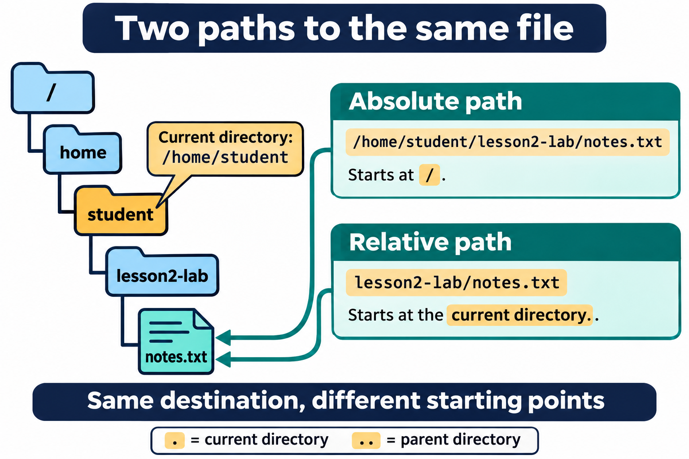
Navigation Fundamentals
Absolute vs. Relative Paths
Absolute Paths (Always start with /)
Unambiguous path starting from root . Resolves identically regardless of current working directory.
/
Relative Paths (Start from current directory)
Shorter and convenient within a workspace. Interpreted relative to .
pwd
Key Special Notation
= User home • = Current directory • = Parent directory
~
.
..

Slide 8
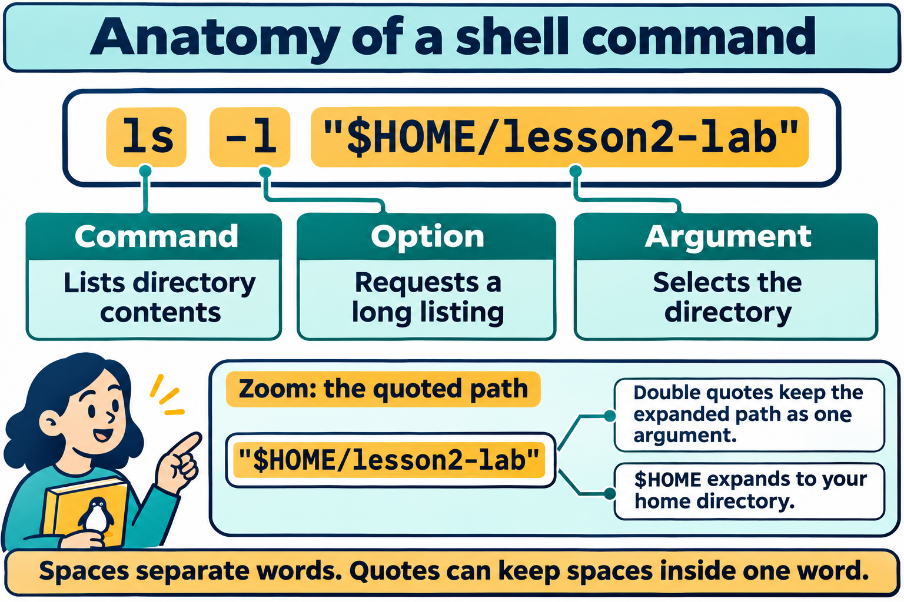
Syntax Mechanics
Anatomy of a Shell Command & Quoting
Whitespace Separates Words
Bash splits words on spaces and tabs unless quoting protects them into a single argument.
Single vs. Double Quotes
Single (' '): Treats all characters literally.
Double (" "): Preserves spaces while permitting variable expansion ().
$HOME
Best Practice Rule
Always quote paths containing variables or potential spaces: .
"$HOME/lesson2-lab"

Slide 9
Execution Control
Chaining Commands with Control Operators
;
&&
||
Sequential
Conditional AND
Conditional OR
Runs commands unconditionally one after the other, regardless of success or failure.
Executes the second command only if the first succeeds (exit status 0).
Executes the second command only if the first fails (nonzero exit status).
mkdir test ; cd test
mkdir test && cd test
cd test || mkdir test

Slide 10
Configuration State
Variables & Export Scope
Shell vs. Environment Variables
# 1. Shell-only variable
VAR='local'
Shell Variable: Visible only to current shell session. Not inherited by child processes.
# 2. Exported to child environment
export EXP='visible to child'
Exported Variable: Exported to environment via . Passed down to every spawned child process.
export
# 3. Test in subshell
bash -c 'echo "$VAR" "$EXP"'
> visible to child
The $PATH Variable: Colon-delimited list of directories searched for executable binaries.
# 4. Remove variables
unset VAR EXP

Slide 11
Customization & Startup
Shell Aliases & Sourcing Setup Files
SHORTCUTS & DEFAULTS
CONFIG & SOURCE
Creating & Removing Aliases
Safe Sourcing with source / .
Aliases substitute a custom shortcut string for a full command and options.
reads and applies commands inside the current shell without opening a new terminal.
source file
|
source lesson2-shell-setup
alias ll='ls -lah'
unalias ll
Aliases exist only in the active shell unless saved into a startup configuration file.
Lab Rule: Use temporary configuration files; avoid editing real directly during early practice.
~/.bashrc

Slide 12
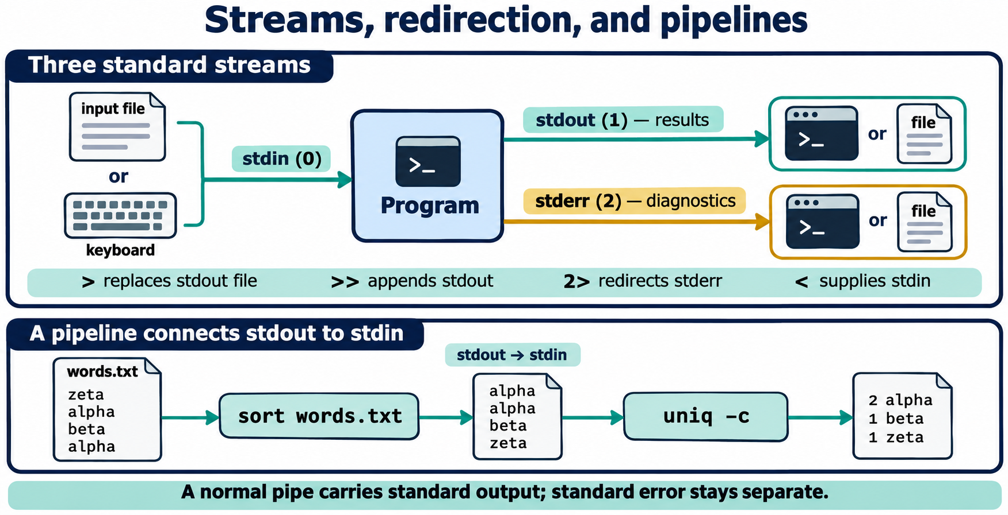
I/O Streams
Standard Streams & File Redirection
Standard Input (stdin / 0)
<
supplies file data into command standard input.
Standard Output (stdout / 1)
>
>>
overwrites file; appends to file.
Standard Error (stderr / 2)
2>
&>
isolates diagnostics; redirects both.

Slide 13
Modular Tool Composition
Connecting Tools with Pipelines (|)
THE PIPE OPERATOR
Direct Process-to-Process Stream Coupling
The operator connects the standard output of one command directly to the standard input of the next command without temporary disk files.
|
Concurrent Processes
Sort Before Uniq
Incremental Construction
Both commands run concurrently as separate processes managed by the kernel.
requires duplicate lines to be adjacent; sorting first is mandatory.
Build complex pipelines one stage at a time and inspect intermediate output.
uniq -c

Slide 14
Process Observability
Observing Processes: ps and top
What is a Process?
ps (Point-in-time Snapshot)
An executing instance of a program loaded in memory. The kernel tracks each process via metadata:
Reports processes active on the current terminal session.
ps -f | ps aux
PID: Unique Process ID integer.
PPID: Parent Process ID (who launched it).
top (Live System Monitor)
USER / STAT: Process owner and execution state.
Real-time dynamic display of CPU, memory, and top tasks.
TTY: Controlling terminal session.
top (press 'q' to exit)

Slide 15
Safe Operation
Safe Process Control: Signals & kill
kill Sends Signals
SIGTERM (Signal 15)
SIGKILL (Signal 9)
does not immediately destroy a program; it transmits an asynchronous signal to a specific PID.
Default request for graceful termination. Allows process to flush buffers, close files, and clean state.
Last resort. Abrupt kernel termination. Bypasses process cleanup handlers and may corrupt data.
kill

Slide 16
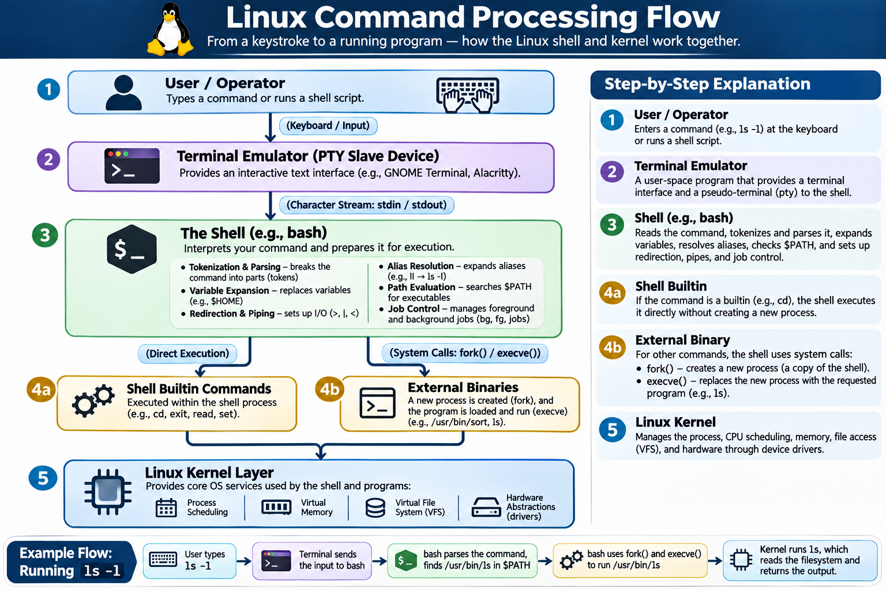

Slide 17
Hands-On Practice
Student Lab: 6-Part Workflow
PART A
PART B
PART C
PART D
PART E
PART F
Prepare Lab
Explore Help
Paths & Quotes
Variables
Redirection
Processes
Create & initial practice files.
Navigate , , and .
Test spaces, relative paths, and quoting.
Create aliases, export vars, and source setup.
Practice , , , and .
Launch background sleep, inspect, and kill PID.
~/lesson2-lab
man
>
>>
info
2>
sort | uniq
apropos

Slide 18
LESSON 2 REVIEW
Key Takeaways & Exit Ticket
"The most important distinction I learned today is how ______ and ______ differ when handling command data, and why ______ requires careful verification before execution."
Quoting and Word Splitting
Pipelines vs. Redirection
Next: Lesson 3 (Files & Directories)

